Slide 1
Wi-Fi:
Starspace 46 guest
Password:
Techlahoma

Slide 2
If you haven’t had a chance to RSVP for today’s meetup yet, please do that now! meetup.com/freecodecampokc

Slide 3
FreeCodeCampOKC.com
facebook.com/groups/free.code.camp.oklahoma.city
linkedin.com/groups/12086660
meetup.com/FreeCodeCampOKC
twitter.com/FreeCodeCampOKC

Slide 4
Thanks for joining us today! We're here thanks to volunteers, speakers, and Techlahoma.

Slide 5
Techlahoma.org
non-profit volunteer-run organization
hosts 33 groups and 2 conferences
sponsors free local events
supports the grassroots tech community of Oklahoma

Slide 6
200OK.us
The annual conference is in Tulsa on May 18th.
Call for sponsors AND call for papers are open.
If your company wants to advertise at 200OK and support Techlahoma, go to 200ok.us and click Sponsors to get more information.

Slide 7
StarSpace46.com
Event Center is donated by StarSpace46.
If you like them and want them to stick around, get a $40 community membership.
www.starspace46.com/calendar-1

Slide 8
donate.techlahoma.org/membership
If you like this meetup and what we do here, please consider becoming a Techlahoma member.
Funding allows Techlahoma to help user groups like this around the state and host 2 great conferences.
Thank you!

Slide 9
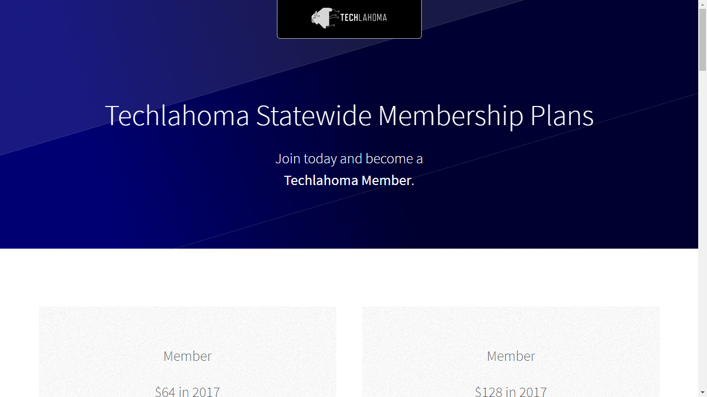
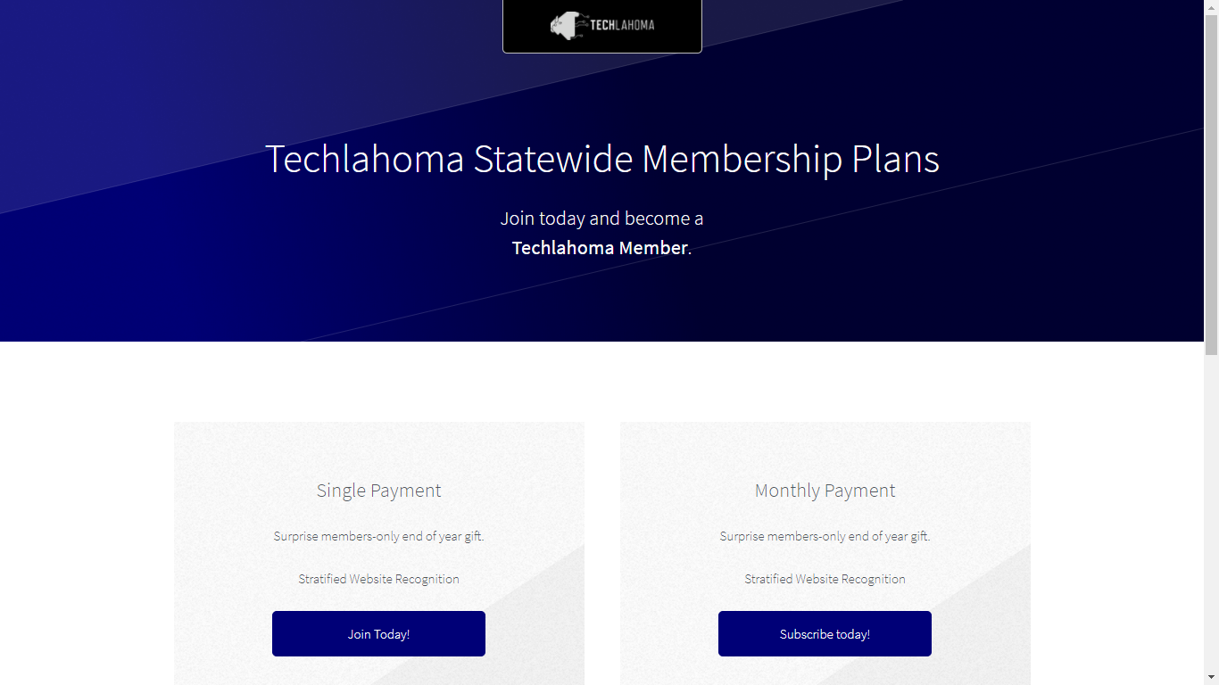

Slide 10
Twitch.tv/Techlahoma
Live streaming at StarSpace46
Subscribe with Amazon Prime
Techlahoma gets a small donation from Amazon

Slide 11
Slack
fccokc.com/slack
Channels for #freecodecamp, #jobs, #javascript, #design, and over 150 other topics

Slide 12
OKC#
Monday 2/5
11:30 - 12:30
Alexa SDK using Amazon and Azure
meetup.com/OKC-Sharp

Slide 13
Hack Night
Tuesday 2/6
6:00 - 8:00 pm
Bring Your Own Project
meetup.com/techlahoma-foundation

Slide 14
OKC Ruby
Thursday 2/8
11:30 - 12:30
Topic to be Announced
meetup.com/okc-ruby

Slide 15
OKC LUGnuts
Friday 2/9
7:00 - 9:00 pm
Topic to be Announced
meetup.com/okc-lugnuts

Slide 16
OKC Open Source Hardware
Saturday 2/10
2:00 - 4:00 pm
Lightning Talks (Sign up to speak!)
meetup.com/okc-osh

Slide 17
Free Code Camp OKC
Sunday 2/11
2:00 - 3:00 pm
Intro to Angular Routing with Patrick Hartley
meetup.com/freecodecampokc

Slide 18
Free Code Camp OKC
Sunday 2/18
2:00 - 3:00 pm
Angular with Jeff Maxwell
meetup.com/freecodecampokc

Slide 19
OKC SQL
Monday 2/19
6:00 - 8:00 pm
Becoming a Public Speaker
meetup.com/okcsql

Slide 20
Free Code Camp OKC
Sunday 2/25
1:00 - 2:00 pm
Lightning Talks (Sign up to speak!)
meetup.com/freecodecampokc

Slide 21
OKC Coffee & Code
Next meetup will be scheduled soon!
Contact Kimberly Collins for details
meetup.com/okccoffeeandcode

